Slide 1

Course5-“Dot_matrix_love”
Yahboom
Yahboom OMIBOX Tutorial

Slide 2
1
2
3
4
5
Learning
goals
Download
code
Experimental
phenomena
Preparation
程序编程
About code
Tencent
Yahboom OMIBOX Tutorial

Slide 3
1
Learning goals
1. The position of the Dot matrix on the robot car
2. Learn about the Arduino board pins connected to the Dot matrix of Omibox programmable robot
Yahboom OMIBOX Tutorial

Slide 4
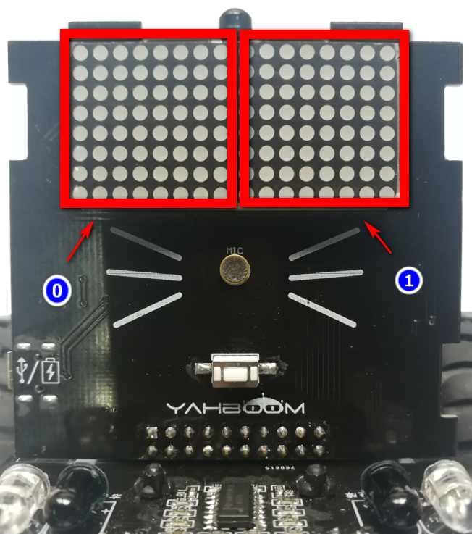
1
Preparation-1
As shown in the above picture, we circled the Dot matrix with two red wire frame. We can use the program to make different colors and brightness.
Yahboom OMIBOX Tutorial

Slide 5
1
Preparation-2
According to the hardware manual, we can see that the pins of the control dot matrix are
DIN-9,
CS-10,
CLK-11.
Yahboom OMIBOX Tutorial

Slide 6
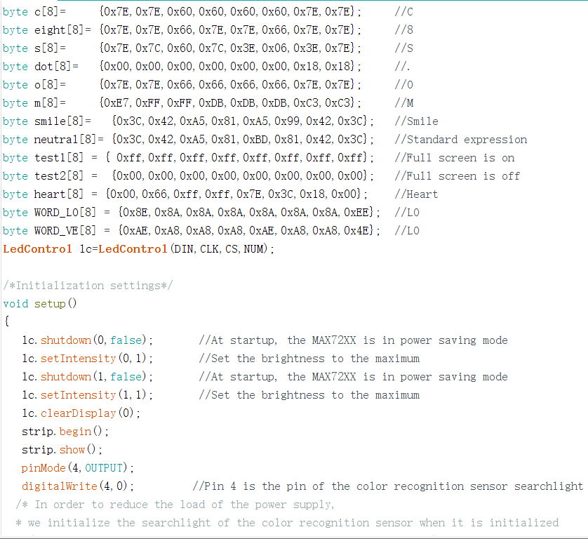
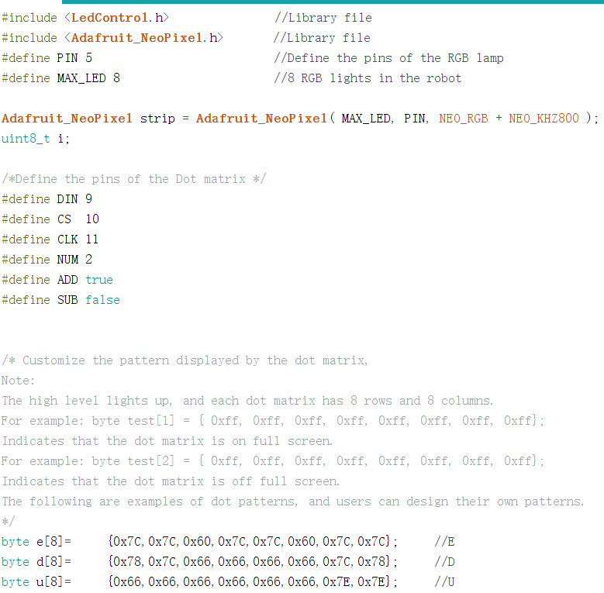
3
About code
The code for this experiment is as follows:
Yahboom OMIBOX Tutorial

Slide 7
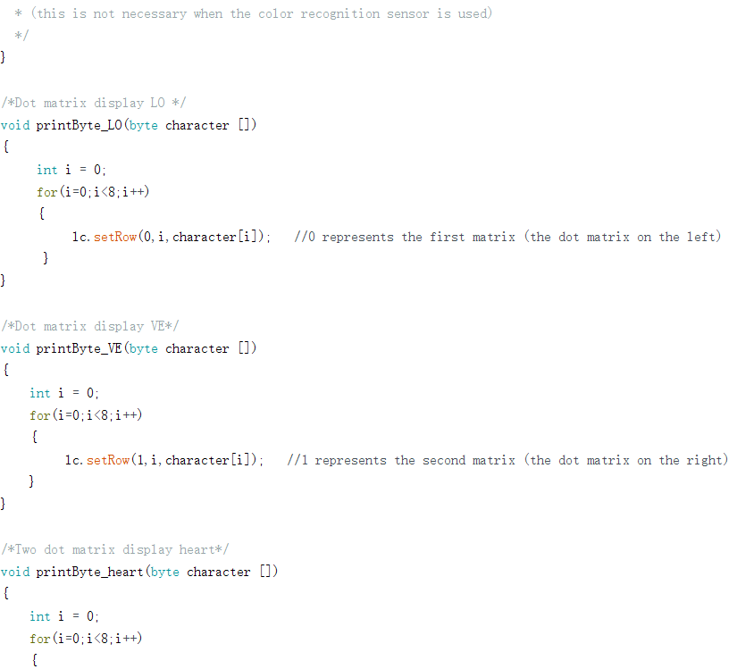
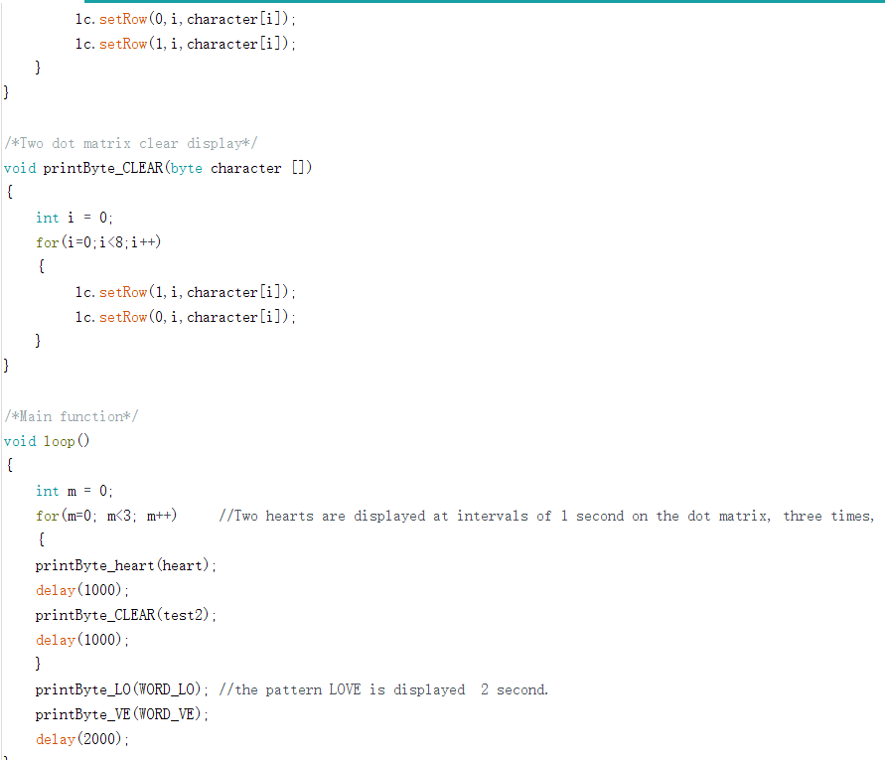
3
About code
Yahboom OMIBOX Tutorial

Slide 8
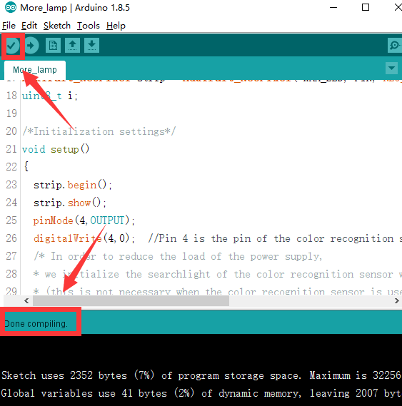
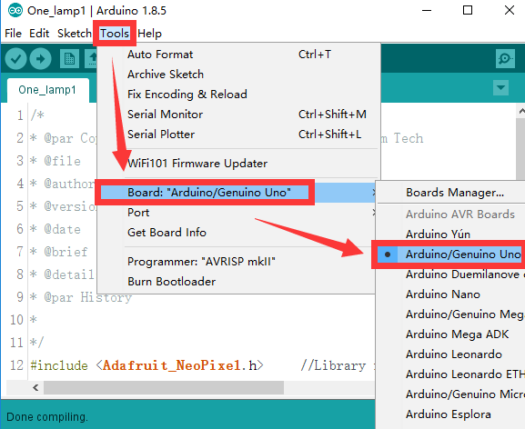
4
Download code
1.We need to open the code of this experiment: Dot_matrix_love.ino, click“√” under the menu bar to compile the code, and wait for the word "Done compiling " in the lower right corner, as shown in the figure below.
2. Click 【Tools】 --- 【Board】 -- we need to choose Arduino Uno. As shown in the figure below.
Yahboom OMIBOX Tutorial

Slide 9
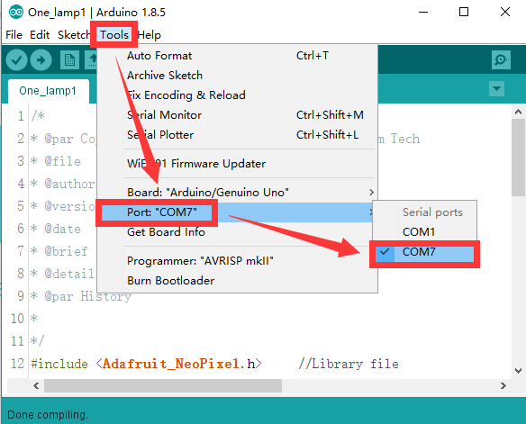
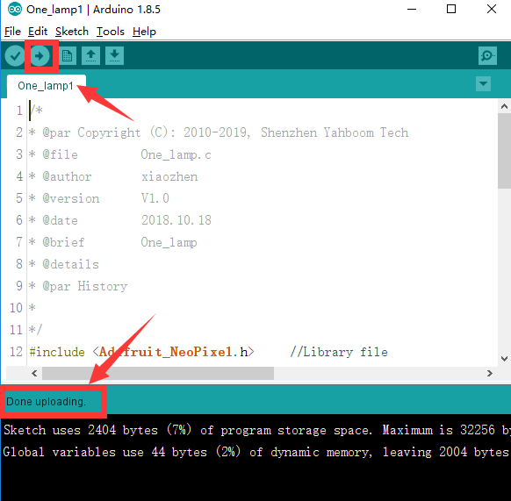
4
Download code
3.In the menu bar of Arduino IDE, we need to select 【Tools】---【Port】--- selecting the port that the serial number displayed by the device manager, as shown in the figure below.
4. After the selection is completed, you need to click “ → ”under the menu bar to upload the code to the Arduino UNO board. When the word “Done uploading” appears in the lower left corner, the code has been successfully uploaded to the Arduino UNO board, as shown in the figure below.
Yahboom OMIBOX Tutorial

Slide 10
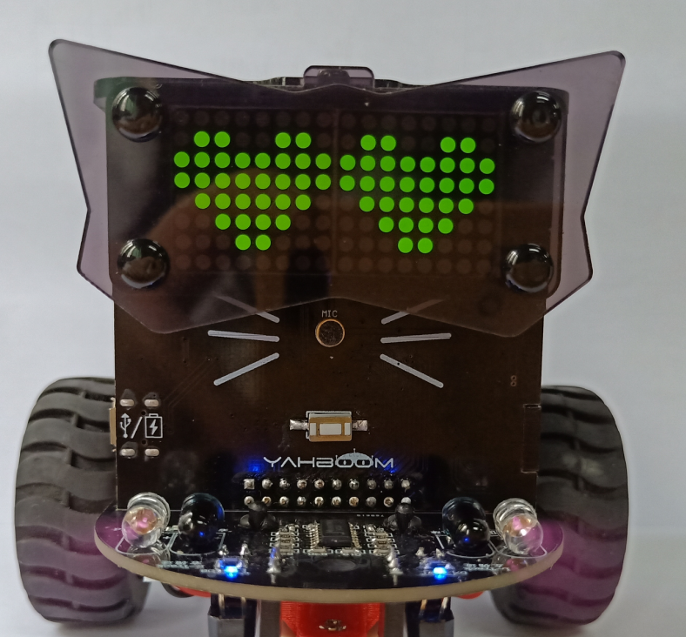
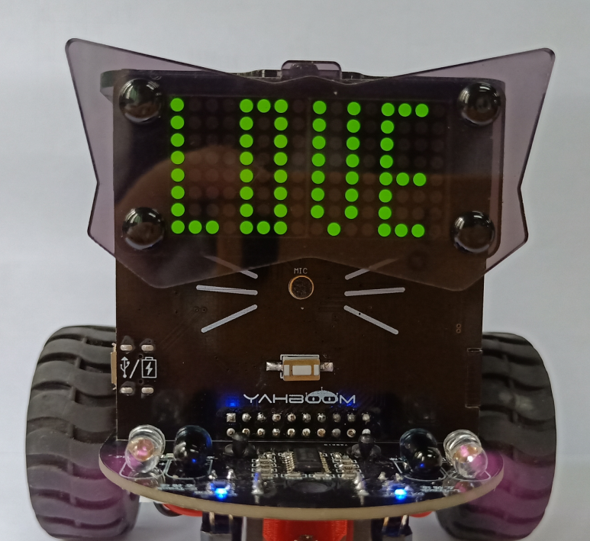
5
Experimental phenomena
After the program is uploaded, open the power of the robot car, and two love patterns are displayed on the dot matrix at intervals of 1 second for three consecutive times, and finally the “LOVE” is displayed on the dot matrix.
Yahboom OMIBOX Tutorial

Slide 11
Inspire Creativity Embrace Innovation
Thank you!!!
Yahboom

